Slide 1
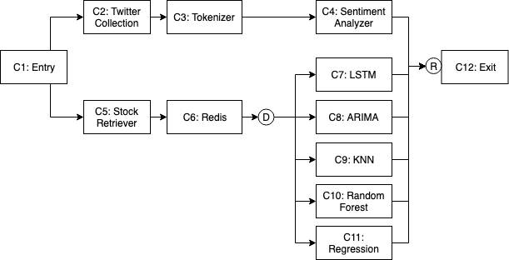
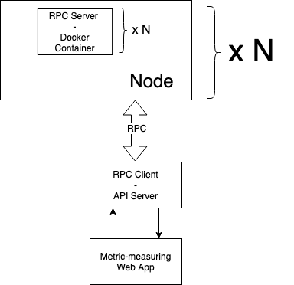
Serving AI on a Distributed Architecture
FYP19060 - Ali Waqas Supervisor: Dr. Heming Cui - Second Examiner: Dr. Chim T. W.
Background
Figure A shows the steps a typical machine learning application has to go through for one request in production.
Problem
Machine learning in production is slow, costly and unable to handle high traffic.
Figure A: Inference pipeline of a stock price prediction service
Solution
Containerise each pipeline task using Docker
Programmatically deploy containers using Terraform
Batch process requests by task using Redis
Remote Procedure Calls (RPC) using gRPC
Architecture-agnostic metrics measurement using React/TypeScript
Deploy on HKU Servers using SSH Tunnelling
Figure B: Solution Architecture
Results
Reduced latency by more than 2x
Decreased throughput/latency growth rate from exponential to linear
Provided tooling for further research in distributed systems for microservice-based pipelines

